Slide 1
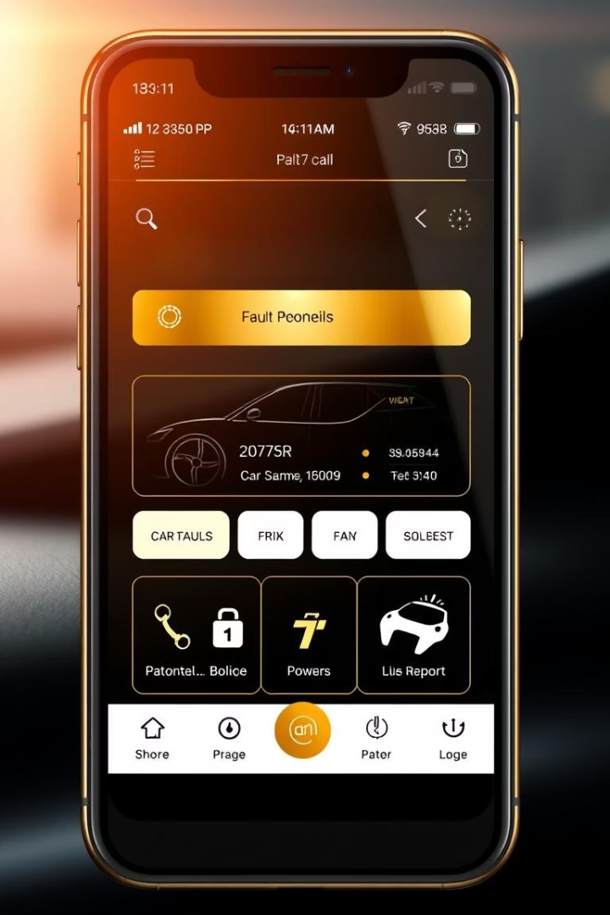
Car Fault Diagnosis Mobile Application: Software Requirements Specification
This presentation outlines the comprehensive Software Requirements Specification (SRS) for a mobile app designed to diagnose car faults using AI-powered dashboard light recognition and engine sound analysis. The app aims to assist car owners with minimal technical knowledge by providing accurate fault detection and repair guidance.
rl
by GROUP 19

Slide 2

Introduction and Project Scope
Purpose
Scope
To define software requirements for a mobile app that diagnoses car faults via dashboard light and engine sound analysis.
The app uses smartphone sensors and AI to identify dashboard symbols, analyse engine sounds, suggest faults, provide tutorials, and operate offline for basic functions.
User Characteristics
Target users include car owners with minimal technical skills, mechanics with moderate knowledge, and developers experienced in React Native and Python.

Slide 3
System Architecture Overview
Mobile Frontend
Backend Server
AI Microservices
Cloud Storage
React Native app handles user interface and sensor inputs (camera, microphone).
API layer routes requests, manages user accounts, diagnostics, and third-party integrations.
Python-based REST APIs perform image and audio fault diagnosis using TensorFlow and PyTorch.
Stores user data, diagnostic logs, and model results securely.

Slide 4
Technology Stack Breakdown
Frontend
Backend
AI & ML
Storage & Notifications
React Native (JavaScript/TypeScript)
Python Flask/FastAPI
TensorFlow, PyTorch, OpenCV for image recognition
JWT/Firebase Authentication
PostgreSQL, Firebase Storage
React Navigation, React-native-camera, React-native-audio
Hosting on Render, Heroku, or VPS
LibROSA, CNN/RNN for audio analysis
Firebase Cloud Messaging for push notifications
Android and iOS support
Model deployment via REST APIs

Slide 5

Requirement Analysis: Objectives and Review
Key Objectives
Completeness Check
Review requirements for completeness, clarity, and feasibility; identify inconsistencies and missing info; prioritise and classify requirements; validate with stakeholders.
Ensures all functional and non-functional needs are documented, including dashboard light recognition and engine sound analysis details.
Clarity Check
Confirms requirements are unambiguous and well-defined, avoiding vague terms and clarifying features like YouTube video suggestions and offline functionality.

Slide 6
Technical Feasibility and Dependency Relationships
Feasibility
Dependencies
AI models for image and sound recognition are feasible with TensorFlow and Python.
AI model training precedes app integration.
Offline mode requires local storage setup first.
Offline mode achievable via model quantization.
YouTube API needs stable internet; mechanic connection requires authentication.
Complex features like mechanic chat deferred for future updates.

Slide 7

Addressing Inconsistencies, Ambiguities, and Missing Information
Inconsistencies
Ambiguities
Missing Information
Resolved conflicts between standalone AI and mechanic integration by making mechanic linking optional.
Clarified offline functionality and confidence score presentation to avoid misinterpretation.
Added requirements for error handling, user feedback, and data privacy, such as deleting recordings after 24 hours.

Slide 8




Requirement Prioritization Using MoSCoW Method
Could Have
Should Have
Mechanic Connection Platform
Must Have
YouTube Video Tutorials
Dashboard Light Recognition
Won't Have
OBD-II Scanner Integration
Engine Sound Analysis
2
3
1
4

Slide 9

Functional Requirements Overview
Offline Mode & User Interaction
Recommendation System
Engine Sound Analysis
Supports basic recognition offline, stores recent diagnostics, allows photo uploads, confidence scores, feedback, and mechanic connections.
Dashboard Light Recognition
Records and classifies engine sounds to match known fault patterns like knocking or squealing.
Suggests repair steps and links to relevant YouTube tutorials.
Detects and interprets dashboard warning lights, providing possible causes and urgency levels.

Slide 10

Non-Functional Requirements and Validation
Performance & Usability
Security & Compatibility
Engine sounds classified within 5 seconds; dashboard symbols recognised with 90% accuracy; simple UI with icons and alerts.
User recordings stored locally and deleted after 24 hours; supports Android and iOS; modular design for updates.
Validation Methods
Prototype testing, surveys, and mechanic interviews ensure requirements meet user needs and technical feasibility.

Slide 11
Validation with Stakeholders
Engage Early
Involve stakeholders from the start to gather diverse perspectives and align expectations.
Prototype Testing
Use prototypes to demonstrate features and receive practical feedback on usability and function.
Iterate Requirements
Refine requirements based on stakeholder feedback to ensure the product meets real needs.
Formal Reviews
Conduct structured validation sessions with users, developers, and project sponsors for approval.
Maintain Traceability
Track changes and feedback systematically to maintain clarity and project continuity.

Slide 12
Conclusion
This specification sets a clear foundation for the car fault diagnosis app.
It balances functionality, usability, and stakeholder validation strategies.
Next steps include detailed design and development phases.
Comprehensive Requirements
Stakeholder Engagement
Future Development
Prototype testing will guide iterative improvements and deployment.
Functional and non-functional needs are well defined and prioritised.
Continuous feedback ensures alignment with user expectations.

